Slide 1






Causal Discovery Introduction to Control and Machine Learning Summer Semester 2024
Apurwa Agrawal
(23161645)
Rahul Ramraje (23081510)
Neelima Kawatra
(22931138)
Sachin
(23276228)
Swarnendu Saha
(22929020)

Slide 2
Abstract
Causal Discovery, the process of identifying causal relationships from data, is crucial in understanding the underlying mechanisms of various phenomena.
This presentation will be focused on the mathematical foundations of Causal Discovery, including graphical models like Bayesian Networks and Structural Equation Models (SEMs).
We explore constraint-based approaches like the PC algorithm.
Through theoretical insights and practical examples, we aim to provide a clear understanding of how mathematical rigor underpins effective Causal Discovery.

Slide 3

Objective
What? Introduction to Causal AI
Oh no! Assumptions in Causal Discovery
Why? Causal Discovery Methods
How? Calculus of Causality
Where? Applications
Alas! Limitations
Wow! Future work

Slide 4
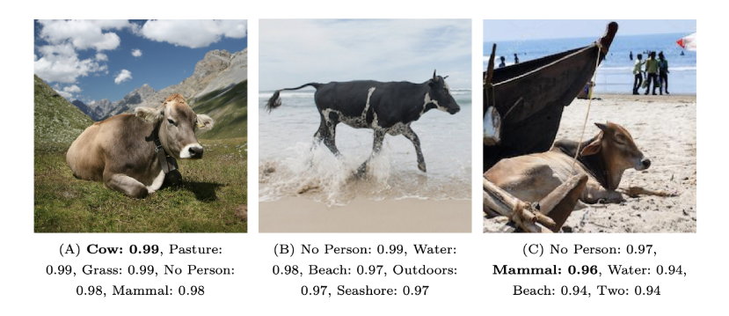
Motivation: Answering what?
Figure: Recognition algorithms generalize poorly to new environments.
Top five labels and confidence produced by ClarifAI.com shown.
Interpolation is great, but we need to extrapolate.

Slide 5

Introduction to our hero: Causality!
Causality is central notion in science, decision-taking and daily life.
How do you define cause and effect?
Cause and Effect:
Cause: An event or factor that brings about a change.
Effect: The change that results from a cause.
Example: A medication (cause) leads to improved health outcomes (effect).
Judea Pearl : “A is the cause of B if B ‘listens to’ A”

Slide 6
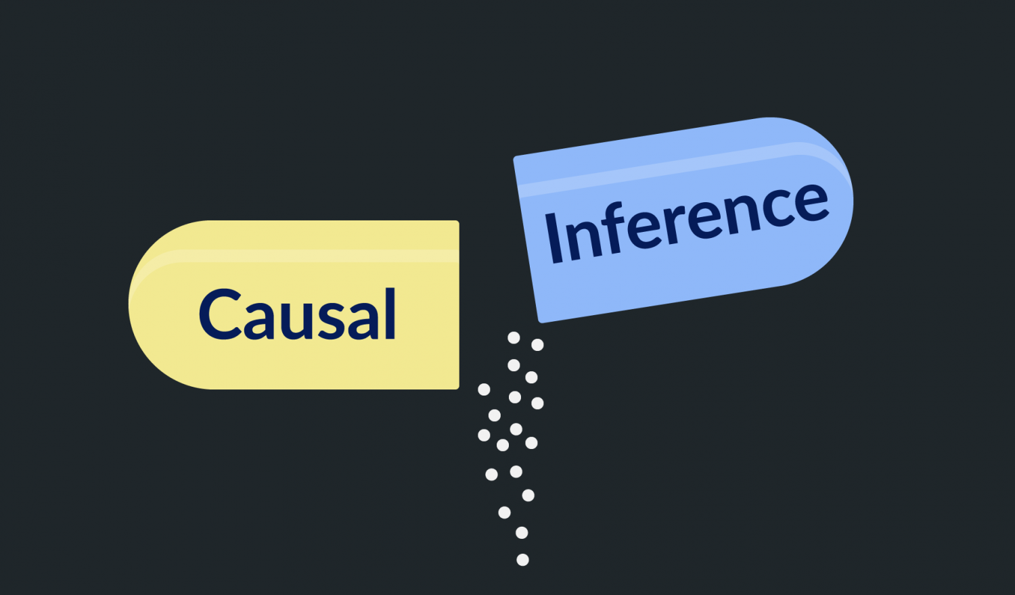
Causal Inference
Causal Inference refers to the process of determining the effect of one variable on another. It aims to establish a cause-and-effect relationship using statistical methods, often from observational or experimental data.
It helps in determining whether and how a change in one variable influences another.

Slide 7
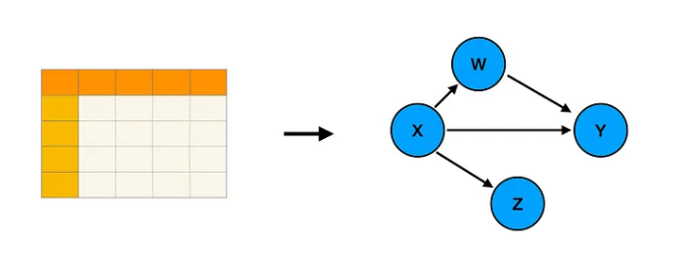
Causal Discovery
Causal discovery aims to uncover the underlying causal structure from the data.
It involves identifying which variables are causes and which are effects without necessarily having prior knowledge of the relationships.
It involves using algorithms and statistical methods to identify potential causal relationships.
Big picture goal of causal discovery: translate data into a causal model. Image by author.

Slide 8
Assumptions!

Slide 9

Faithfulness Assumption
Markov assumption: $X \text{⫫}\text{G} Y | Z⟹ X \text{⫫}\text{P} \text{Y}\text{ | }\text{Z}$

Slide 10

Faithfulness Assumption
Markov assumption: $X \text{⫫}\text{G} Y | Z⟹ X \text{⫫}\text{P} \text{Y}\text{ | }\text{Z}$
Causal graph Data
Causal graph Data

Slide 11

Faithfulness Assumption
Markov assumption: $X \text{⫫}\text{G} Y | Z⟹ X \text{⫫}\text{P} \text{Y}\text{ | }\text{Z}$
Causal graph Data
Causal graph Data
Faithfulness: $X \text{⫫}\text{G} Y | Z⟸ X \text{⫫}\text{P} \text{Y}\text{ | }\text{Z}$

Slide 12

Violation of Faithfulness
Faithfulness: $X \text{⫫}\text{G} Y | Z⟸ X \text{⫫}\text{P} \text{Y}\text{ | }\text{Z}$
A
B
C
D

Slide 13

Violation of Faithfulness
B := 𝛼 A
C := 𝜸 A
D := β B + 𝛿 C
Faithfulness: $X \text{⫫}\text{G} Y | Z⟸ X \text{⫫}\text{P} \text{Y}\text{ | }\text{Z}$
A$\text{⫫} \text{D}$
but A and D aren’t d-separated
A
𝛼
𝜸
B
C
β
𝛿
D

Slide 14

Violation of Faithfulness
B := 𝛼 A
C := 𝜸 A
D := β B + 𝛿 C
D = (𝛼 β + 𝜸 𝛿) A
Paths cancel if 𝛼 β = - 𝜸 𝛿
Faithfulness: $X \text{⫫}\text{G} Y | Z⟸ X \text{⫫}\text{P} \text{Y}\text{ | }\text{Z}$
A$\text{⫫} \text{D}$
but A and D aren’t d-separated
A
𝛼
𝜸
B
C
β
𝛿
D

Slide 15
Causal Sufficiency and Acyclicity
Causal Sufficiency:
there are no unobserved confounders of any of the variables in the graph.
Acyclicity:
still assuming there are no cycles in the graph.

Slide 16
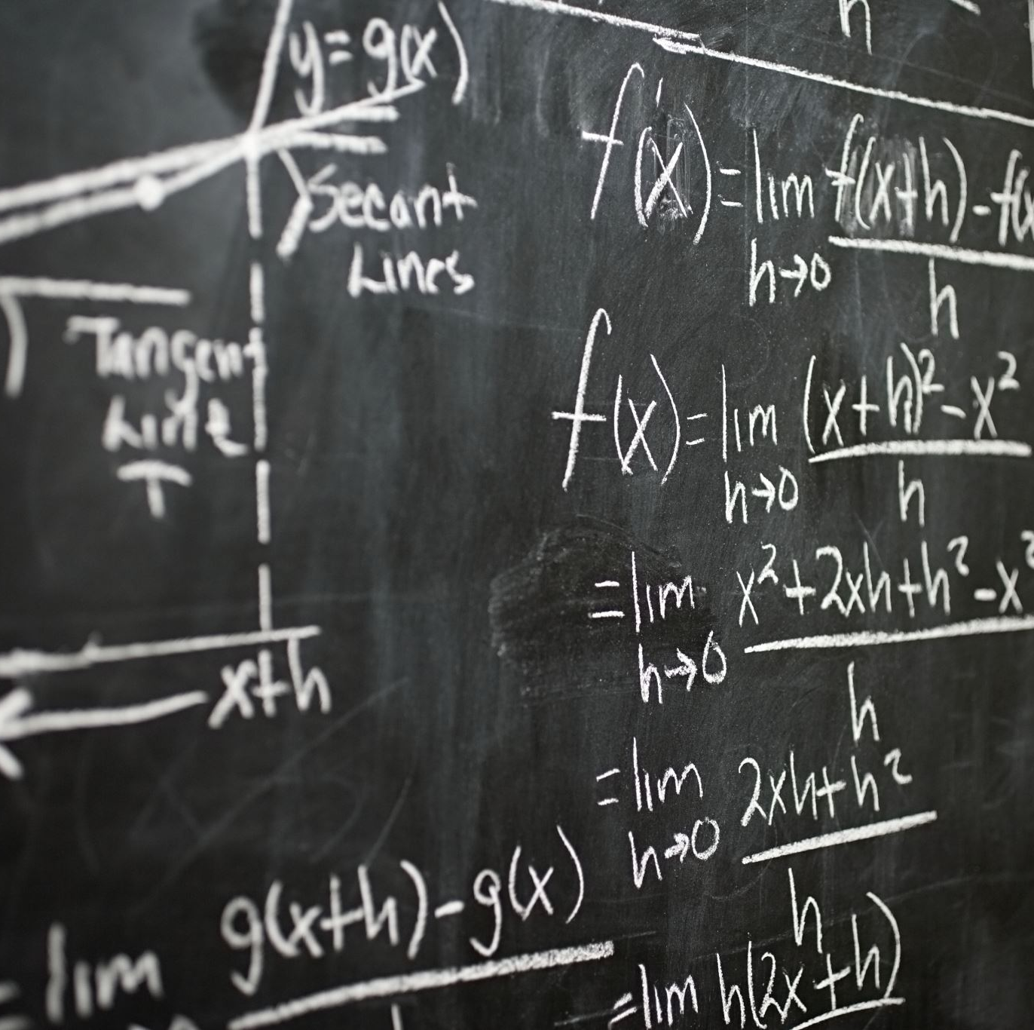
Causal discovery methods
Constraint-based
Score-based

Slide 17
Constraint-based method
Constraint-based methods aim to construct a causal graph by exploiting the conditional independencies observed in the data.
Assume faithfulness, where data independence relationships match the graph.
Perform statistical tests to identify CIS and structure the causal graph.
PC Algorithm

Slide 18
D-separation
A ⫫ C | B
A
B
C
Chain
B
A ⫫ C | B
Fork
A
C
A
C
A ⫫ C | B
Collider
B

Slide 19
Score based method
Greedy Equivalent Search (GES) Algorithm
Score-based algorithms aim to find the best causal graph by maximizing a fitness measure S(G,D) across possible graphs G.
This measure evaluates how well a graph explains the relationships observed in the data.
G = argmax S(G, D)
G ∈ G

Slide 20
The Calculus of Causality!!

Slide 21
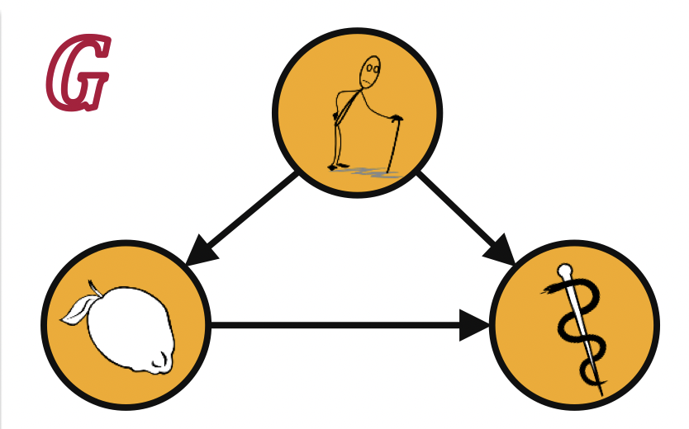
The Calculus of causality
Causality – not well defined ?
Probability theory has an associational, and not a causal nature
Assume that the data is generated by model G
The recovery of scurvy is casually influenced by the treatment with lemons
But now both the recovery of scurvy as well as the treatment with lemons are causally influenced by the age of the sailors
The question remains:
Should we treat scurvy with Lemons?

Slide 22
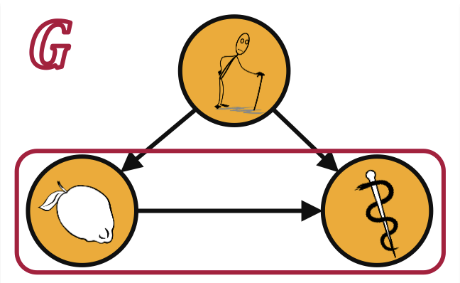
The Calculus of causality
We run an experiment w.r.t. the model G, i.e., we favor old sailors for treatment with lemons
The observed data for all sailors:
Combined | Recovery | No Recovery | Total | Recovery Rate
No Lemons | 20 | 20 | 40 | 50 %
Lemons | 16 | 24 | 40 | 40 %
Total | 36 | 44 | 80
Hence, we see that
P(recovery | lemons) < P(recovery | no lemons)

Slide 23
The Calculus of causality
The observed data for old sailors:
The observed data for young sailors:
Combined | Recovery | No Recovery | Total | Recovery Rate
No Lemons | 2 | 8 | 10 | 20 %
Lemons | 9 | 21 | 30 | 30 %
Total | 11 | 29 | 40
Combined | Recovery | No Recovery | Total | Recovery Rate
No Lemons | 18 | 12 | 30 | 60 %
Lemons | 7 | 3 | 10 | 70 %
Total | 25 | 15 | 40
P(recovery | lemons,old) > P(recovery | no lemons, old)
P(recovery|lemons, young) > P(recovery | no lemons, young)

Slide 24
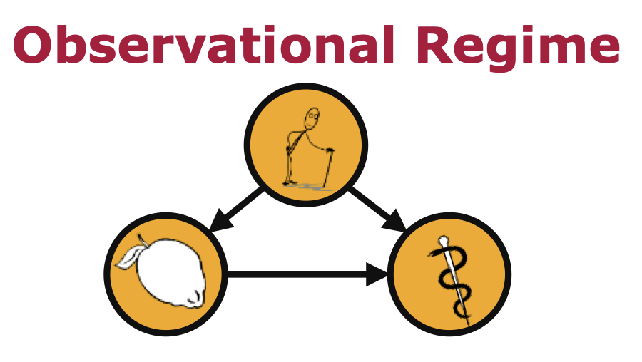
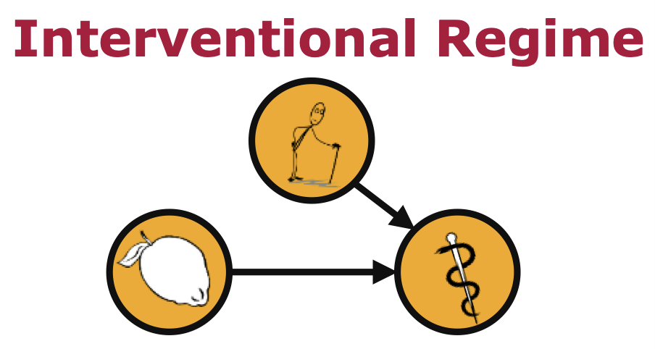
The Calculus of causality
Simpson’s Paradox : Reversal association between two variables after considering the third variable .
In an interventional regime, all influences stemming from “natural causes” of the exposure variable are removed.
New operator – Pearl’s do-operator

Slide 25
The Calculus of causality
Resolution of the Simpson’s paradox
We should treat scurvy with lemons if
P(recovery|do(lemons)) > P(recovery|do(no lemons))
Derivation of do-operator
If identifiable,
P(.|do(.)) can be calculated from G and observational Data
In our example, we have
P(recovery|do(lemons)) = ⅀P(age) P(recovery|age,lemons) = 0.5
P(recovery|do(no lemons)) = ⅀P(age) P(recovery|age,no lemons) = 0.4

Slide 26
The Concept
Traditional Statistical Inference Paradigm
Paradigm of Structural Causal Models
Data generating Model (G)
Aspect of G (Q(G))
Aspect of P (Q(P))
Joint Distribution (P)
Inference
Data
Inference
What is the sailors’ probability of recovery when we see a treatment with lemons?
What is the sailors’ probability of recovery if we do treat them with lemons?
Q(P) = P(recovery | lemons)
Q(P) = P(recovery | do(lemons))

Slide 27

Applications
Healthcare
Personalized treatment plans, drug discovery.
Finance
Enhanced investment strategies, financial decision-making.
Marketing
Customer behavior analysis, marketing strategy optimization.
Notes:
Explain a short example – only one

Slide 28
Limitations and Future Works
Limitations:
Data Dependency: Requires high-quality, unbiased data.
Assumption Sensitivity: Incorrect assumptions can lead to wrong conclusions.
Limited Generalizability: Models may not work well in different contexts.
Future Solutions:
Enhanced Data Collection and Cleaning: Advanced tools and techniques to ensure unbiased, high-quality data.
Dynamic Assumption Testing: Continuous validation and updating of assumptions with real-time data.
Efficient Algorithms: Development of more efficient algorithms.
Transfer Learning and Diverse Training Data: Use transfer learning and diverse datasets to improve model adaptability.

Slide 29
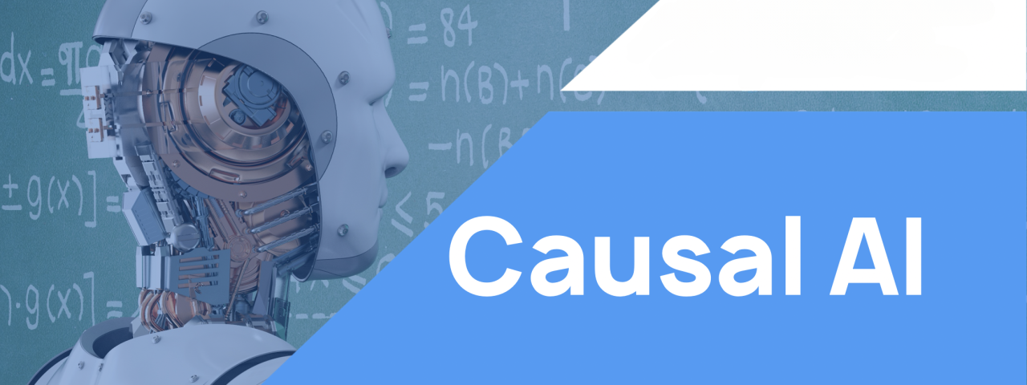
Conclusion
Improves decision accuracy by understanding true cause-and-effect relationships.
Enhances outcome across industries like healthcare, finance and, more.
Notes:
Think better- an image or a small video to end , tell this is a model but it also has limitations which need to be worked out as future work…..

Slide 30

References
Pearl, J., Glymour, M., & Jewell, N. P. (2016). Causal Inference in Statistics: A Primer. John Wiley & Sons. https://doi.org/10.1002/9781119186847
Plattner, H. (2017). Causal Inference: Theory and Applications. https://hpi.de/fileadmin/user_upload/fachgebiete/plattner/teaching/CausalInference/04_17_Causal_Inference-Theory_and_Applications.pdf
CMPT 727 Spring 2023. Mathematical, Statistical, and Probabilistic Foundations of Machine Learning. https://www.youtube.com/playlist?list=PL_5SuHtr8fsrK9NqWWSL4YL8urMAHLsvU
Peters, J., Janzing, D., & Schölkopf, B. (2017). Elements of Causal Inference: Foundations and Learning Algorithms. MIT Press. https://doi.org/10.7551/mitpress/11444.001.0001

Slide 31

THANK YOU
We are open for questions now!

